Slide 1

CAP538 ALGORITHM DESIGN AND ANALYSIS
Unit 1
By Dr. Ajay Rastogi

Slide 2
Unit 1 : Introduction
Elementary Data Structures
Basic Computational Models
Analysis of algorithms: best case, average case and worst-case
Asymptotic Notations: Big O, Omega and Theta Notation
Recursion
Recurrence relations to analyze recursive algorithms

Slide 3
Elementary Data Structures
Elementary data structures such as stacks, queues linked lists etc. are the main components we build our algorithm from.
There are two aspects to any data structure :
The abstract operations which it supports
The implementation of these operations
The fact that we can describe the behavior of our data structures in terms of abstract operations explains why we can use them without thinking, while the fact that we have different implementation of the same abstract operations enables us to optimize performance.

Slide 4
Elementary Data Structures
“A data structure is a group of data elements that provides the easiest way to store and perform different actions on the data of the computer. A data structure is a particular way of organizing data in a computer so that it can be used effectively. The idea is to reduce the space and time complexities of different tasks.”
The choice of a good data structure makes it possible to perform a variety of critical operations effectively.
An efficient data structure uses
minimum memory space and
Minimum execution time to process the structure.

Slide 5
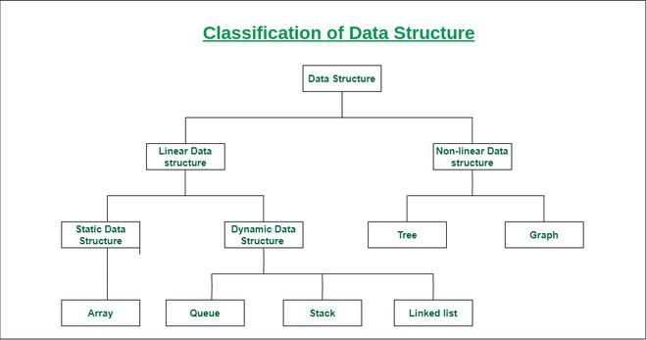
Elementary Data Structures
Data Structures Classification :

Slide 6
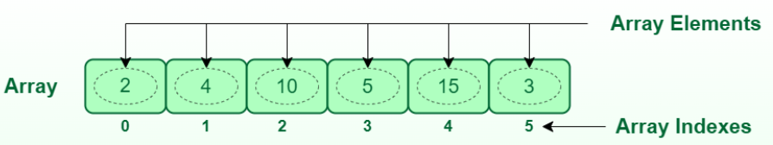
Elementary Data Structures
Array
An array is a collection of items stored at contiguous memory locations. The idea is to store multiple items of the same type together. This makes it easier to calculate the position of each element by simply adding an offset to a base value, i.e., the memory location of the first element of the array (generally denoted by the name of the array).
Array is static, meaning that we need to declare the size of the array before using it. Once it is declared, size cannot be modified.

Slide 7
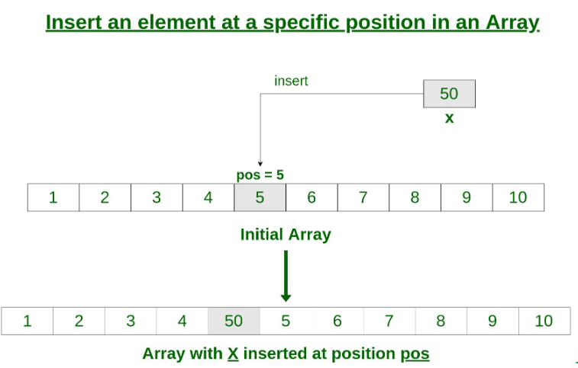
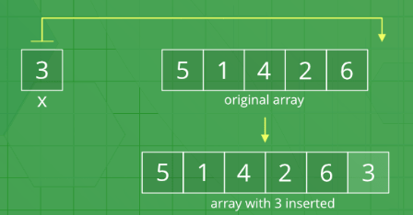
Elementary Data Structures
Array Operations : 1) Insert Operation
1. Insert at the end: 2. Insert at any position
- Much faster - Relatively slower
- Complexity O(1) - Complexity O(N) (Worst case)
- Do not care about shifting - Performed by shifting elements to the right
- Overflow, if array is full - Overflow, if array is full

Slide 8
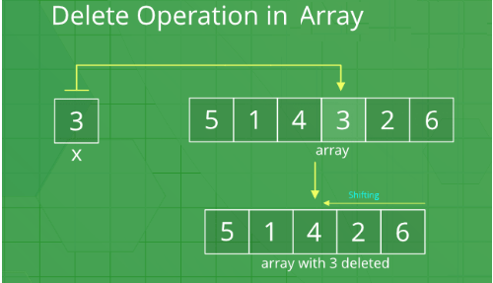
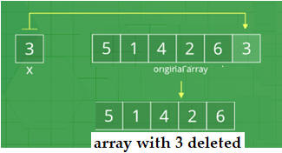
Elementary Data Structures
Array Operations : 2) Delete Operation
1. Delete at the end: 2. Delete from any position
- Much faster - Relatively slower
- Complexity O(1) - Complexity O(N) (Worst case)
- Do not care about shifting - Performed by shifting elements to the left
- Underflow, if array is empty - Underflow, if array is empty

Slide 9
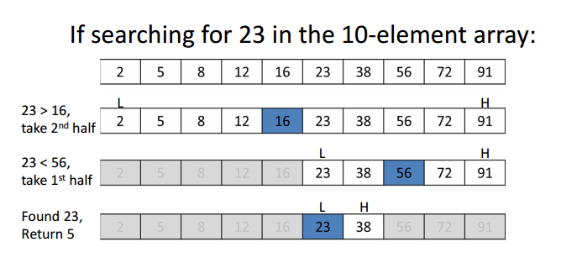
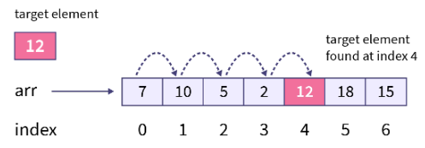
Elementary Data Structures
Array Operations : 3) Search Operation
1. Linear Search: 2. Binary Search
- Slower - Relatively much faster
- Complexity O(N) - Complexity O(Log N)
- performed by linear traversal - performed by dividing the array into two
from the first element to the last parts using divide and conquer technique
element.
- Array does not need to be sorted - Array need to be sorted beforehand.

Slide 10

Thank You

